Slide 1
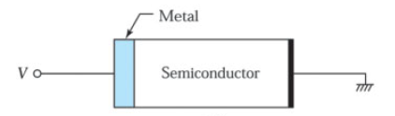
METAL-SEMICONDUCTOR CONTACTS
The first practical semiconductor device was the metal-semiconductor contact in the form of a point-contact rectifier, that is, a metallic whisker pressed against a semiconductor. The device found many applications beginning in 1904.
In 1938, Schottky suggested that the rectifying behavior could arise from a potential barrier
as a result of the stable space charges in the semiconductor. The model arising from this concept is known as the Schottky barrier.
Metal-semiconductor contacts can also be nonrectifying; that is, the contact has negligible
resistance regardless of the polarity of the applied voltage. This type of contact is called an ohmic contact.
All semiconductor devices as well as integrated circuits need ohmic contact to make connections to other devices in an electronic system. We consider the energy band diagram and the current-voltage characteristics of both the rectifying and ohmic metal-semiconductor contacts.
Dr. S. RANJITH / Physics, SRM IST

Slide 2
The Schottky Barrier
A Schottky barrier refers to a metal-semiconductor contact having a large barrier height
(i.e., ϕ_{Bn} or ϕ_{Bp} >> kT) and a low doping concentration that is less than the density of states in the
conduction band or valence band.
[The barrier height ϕ_{Bn} is simply the difference between the metal work function and the
semiconductor electron affinity
The barrier height ϕ_{Bp} is simply an ideal contact between a metal and a p-type semiconductor]
The current transport in a Schottky barrier is due mainly to majority carriers, unlike a p-n junction
where current transport is due mainly to minority carriers.
For Schottky diodes operated at moderate temperature (e.g.,300 K), the dominate transport
mechanism is thermionic emission of majority carriers from the semiconductor over the
potential barrier into the metal
Dr. S. RANJITH / Physics, SRM IST

Slide 3
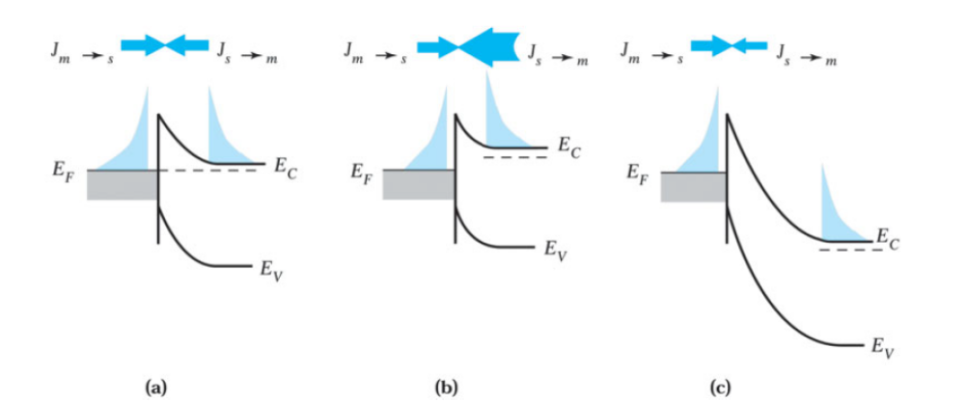
Current transport by the thermionic emission process. (a) Thermal equilibrium;
(b) forward bias; and (c) reverse bias
Dr. S. RANJITH / Physics, SRM IST

Slide 4

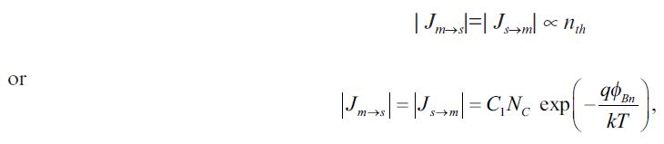
At thermal equilibrium (Fig. a), the current density is balanced by two equal and opposite flows of carriers, and thus there is zero net current. Electrons in the semiconductor tend to flow (or emit) into the metal, and there is an opposing balanced flow of electrons from metal into the semiconductor. These current components are proportional to the density of electrons at the
boundary.
At the semiconductor surface an electron can be thermionically emitted into the metal if its energy is above the barrier height. Here the semiconductor work function qϕ_{s} is replaced by qϕ_{Bn} and
where N_{C} is the density of states in the conduction band. At thermal equilibrium we have
Dr. S. RANJITH / Physics, SRM IST

Slide 5

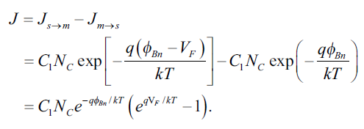
where J_{m→s} is the current from the metal to the semiconductor, J_{s→ m} is the current from the semiconductor to the metal, and C₁ is a proportionality constant.
When a forward bias V_{F} is applied to the contact (Fig.b), the electrostatic potential difference across the barrier is reduced, and the electron density at the surface increases to
The current J_{s→m} that results from the electron flow out of the semiconductor is therefore
altered by the same factor (Fig.b). The flux of electrons from the metal to the semiconductor,
however, remains the same because the barrier ϕ_{Bn} remains at its equilibrium value. The net
current under forward bias is then
With the same argument for the reverse-bias condition (see Fig. c), the expression for the net
current is identical to the above equation, except that V_{F} is replaced by –V_{R}.
Dr. S. RANJITH / Physics, SRM IST

Slide 6
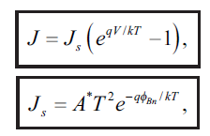
The coefficient C₁N_{C} is found to be equal to A*T², where A* is called the effective Richardson constant
(in units of A/K²-cm²) and T is the absolute temperature. The value of A* depends on the
effective mass.
The current-voltage characteristic of a metal-semiconductor contact under thermionic emission condition is then
where J_{s} is the saturation current density and the applied voltage V is positive for forward bias
and negative for reverse bias.
In addition to the majority carrier (electron) current, a minority-carrier (hole) current exists in a metal n-type semiconductor contact. The electron-hole pairs can be easily created in the valence band (interband transition) in the depletion region. Electrons in the valence band flow into the metal because there is no barrier there and holes diffuse into the semiconductor to form the minority current under forward bias. The hole diffusion current is the same as in a p-n junction.
Dr. S. RANJITH / Physics, SRM IST

Slide 7
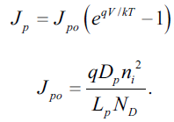
The current density is given by
Under normal operating conditions, the minority-carrier diffusion current is orders of magnitude smaller than the majority-carrier current. Therefore, a Schottky diode is a unipolar device (i.e., predominately only one type of carrier participates in the conduction process). The minimum minority-carrier storage makes the Schottky barrier to operate at much higher frequencies (~100 GHz) compared to a p-n junction (~1 GHz).
Dr. S. RANJITH / Physics, SRM IST

Slide 8
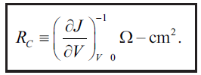

The Ohmic Contact
An ohmic contact is defined as a metal-semiconductor contact that has a negligible contact resistance relative to the bulk or series resistance of the semiconductor. A satisfactory ohmic contact should not significantly degrade device performance and can pass the required current with a voltage drop that is small compared with the drop across the active region of the device.
A figure of merit for ohmic contacts is the specific contact resistance R_{C}, defined as
For metal-semiconductor contacts with low doping concentrations, the thermionic-emission current dominates the current transport
Above equation shows that a metal-semiconductor contact with a low barrier height should be
used to obtain a small R_{C}
Dr. S. RANJITH / Physics, SRM IST

Slide 9




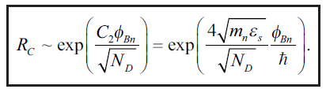
For contacts with high doping concentration, the barrier width becomes very narrow, and the tunneling current becomes dominant.
The tunneling current is proportional to the tunneling probability
where W is the depletion-layer width, which can be approximated as
m_{ħ} is the effective mass, and ħ - is the reduced Planck constant. In above equation substituting W, we obtain.
Where
The specific contact resistance for high doping is thus
Dr. S. RANJITH / Physics, SRM IST

Slide 10

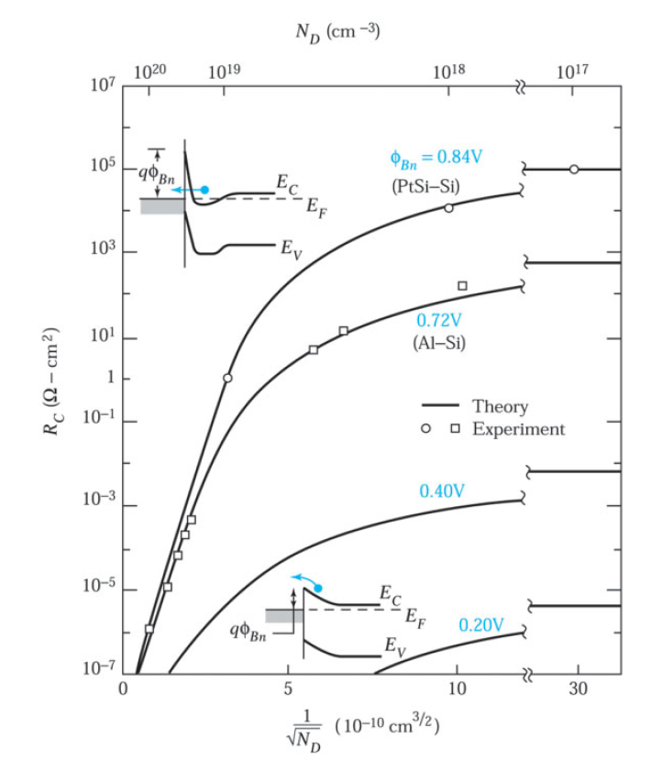
The above equation shows that in the tunneling range the specific contact resistance depends strongly on doping concentration and varies exponentially with the factor
For N_{D} ≥ 10¹⁹ cm^{–3}, R_{C} is dominated by the tunneling process and decreases rapidly with increased doping. On the other hand, for N_{D} ≤ 10¹⁷ cm^{–3}, the current is due to thermionic emission, and R_{C} is essentially independent of doping.
Calculated and measured values of specific contact resistance. Upper inset shows the tunneling process, lower inset shows thermionic emission over the low barrier
Dr. S. RANJITH / Physics, SRM IST

